Slide 1
Verilog Part 1
Combinational Circuits

Slide 2
Verilog
Contents
  Verilog HDL
    structured modeling
    RTL modeling
  Example combinational circuits
    structured description (net-list)
    RTL
  Example sequential circuits (Part 2)
    RTL
  FSM (Part 2)
    combinational circuits
    sequential circuits

Slide 3
Hardware Description Languages
The functionality of hardware
  concurrency
  timing controls
The implementation of hardware
  structure
  net-list

Slide 4
Different Levels of Abstraction
Algorithmic
  the function of the system
RTL
  the data flow
  the control signals
  the storage element and clock
Gate
  gate-level net-list
Switch
  transistor-level net-list

Slide 5
Verilog for Digital System Design
Structural description
  net-list using primitive gates and switches
  continuous assignment using Verilog operators
RTL
  functional description
  timing controls and concurrency specification
  procedural blocks (always and initial)
  registers and latches
Timing controls + concurrency
An HDL to specify your design

Slide 6
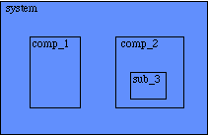
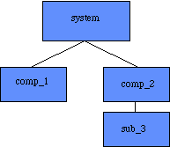
Hierarchical structure
Represent the hierarchy of a design
  modules
    the basic building blocks
  ports
    the I/O pins in hardware
    input, output or inout

Slide 7
Modules
The principal design entity
Module Name &
Port List
Definitions
Ports, Wire, Reg,
Parameter
Module Statements &
Constructs
Module
Instatiations

Slide 8
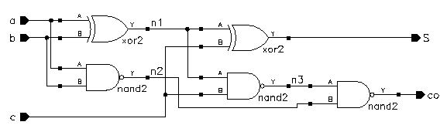
Examples
A full-adder
  module add (co, s, a, b, c)
    input a, b ,c ;
    output co, s ;
      xor (n1, a, b) ;
      xor (s, n1, c) ;
      nand (n2, a, b) ;
      nand (n3,n1, c) ;
      nand (co, n3,n2) ;
  endmodule

Slide 9
Examples
4-bit adder
  module add4 (s,c3,ci,a,b)
    input [3:0] a,b ; // port declarations
    input ci ;
    output [3:0] s : // vector
    output c3 ;
    wire [2:0] co ;
      add a0 (co[0], s[0], a[0], b[0], ci) ;
      add a1 (co[1], s[1], a[1], b[1], co[0]) ;
      add a2 (co[2], s[2], a[2], b[2], co[1]) ;
      add a3 (c3, s[3], a[3], b[3], co[2]) ;
  endmodule
c3
a3
a2
a1
a0
ci

Slide 10
Data types
Net
  physical wire between devices
  the default data type
  used in structural modeling and continuous assignment
  types of nets
    wire, tri : default
    wor, trior : wire-ORed
    wand, triand : wire-ANDed
    trireg : with capacitive storage
    tri1 : pull high
    tri0 ; pull low
    supply1 ; power
    supply0 ; ground

Slide 11
Reg
  variables used in RTL description
  a wire, a storage device or a temporary variable
  reg : unsigned integer variables of varying bit width
  integer : 32-bit signed integer
  real : signed floating-point
  time : 64-bit unsigned integer
Parameters
  run-time constants

Slide 12
Special Language Tokens
$<identifier>: System tasks and functions
  $time
  $stop
  $finish
  $monitor
#<delay specification>
  used in
    gate instances and procedural statements
    unnecessary in RTL specification
  ‘timescale 1ns / 10ps - specifies time unit/precision

Slide 13
Modeling Structures
Net-list
  structural description for the top level
Continuous assignments (combination circuits)
  data flow specification for simple combinational
  Verilog operators
Procedural blocks (RTL)
  always and initial blocks
    allow timing control and concurrency
  C-like procedure statements

Slide 14
Gate-Level Modeling
Net-list description
  built-in primitives gates
A full-adder
  module add (co, s, a, b, c)
    input a, b ,c ;
    output co, s ;
      xor (n1, a, b) ;
      xor (s, n1, c) ;
      nand (n2, a, b) ;
      nand (n3,n1, c) ;
      nand (co, n3,n2) ;
  endmodule

Slide 15
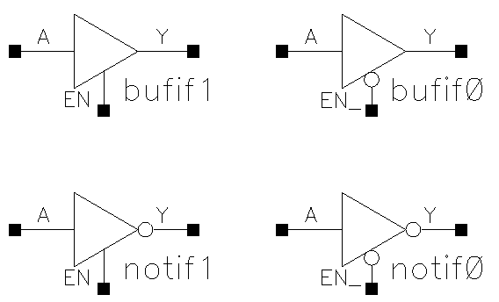
Verilog Primitives
Basic logic gates only
  and
  or
  not
  buf
  xor
  nand
  nor
  xnor
  bufif1, bufif0
  notif1, notif0

Slide 16
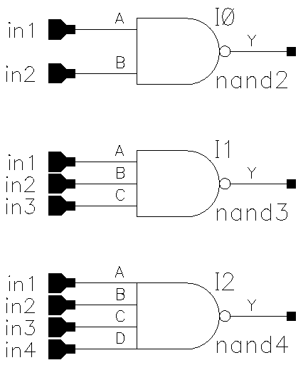
Primitive Pins Are Expandable
One output and variable number of inputs
not and buf
  variable number of outputs but only one input
nand (y, in1, in2) ;
nand (y, in1, in2, in3) ;
nand (y, in1, in2, in3, in4) ;

Slide 17
Continuous Assignments
Describe combinational logic
Operands + operators
Drive values to a net
  assign out = a&b ; // and gate
  assign eq = (a==b) ; // comparator
  wire #10 inv = ~in ; // inverter with delay
  wire [7:0] c = a+b ; // 8-bit adder
Avoid logic loops
  assign a = b + a ;
  asynchronous design

Slide 18
Operators
{ } concatenation
+ - * /
arithmetic
% modulus
> >= < <=
relational
! logical NOT
&& logical AND
|| logical OR
== logical equality
!= logical inequality
? : conditional
~ bit-wise NOT
& bit-wise AND
| bit-wise OR
^ bit-wise XOR
^~ ~^ bit-wise XNOR
& reduction AND
| reduction OR
~& reduction NAND
~| reduction NOR
^ reduction XOR
~^ ^~ reduction XNOR
<< shift left
>> shift right

Slide 19
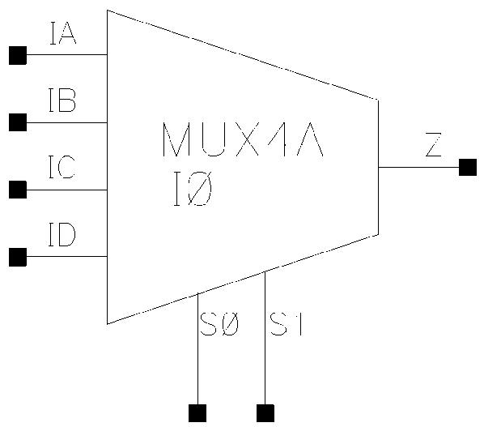
Logical, bit-wise and unary operators
  a = 1011; b = 0010
  logical bit-wise unary
  a || b = 1 a | b = 1011 |a = 1
  a && b = 1 a &b = 0010 &a = 0
Conditional operator
  assign z = ({s1,s0} == 2'b00) ? IA :
  ({s1,s0} == 2'b01) ? IB :
  ({s1,s0} == 2'b10) ? IC :
  ({s1,s0} == 2'b11) ? ID :
  1'bx ;
  assign s = (op == ADD) ? a+b : a-b ;

Slide 20
Operator Precedence
[ ] bit-select or part-select
( ) parentheses
!, ~ logical and bit-wise negation
&, |, ~&, ~|, ^, ~^, ^~ reduction operators
+, - unary arithmetic
{ } concatenation
*, /, % arithmetic
+, - arithmetic
<<, >> shift
>, >=, <, <=
relational
==, != logical equality
& bit-wise AND
^, ^~, ~^
bit-wise XOR and XNOR
| bit-wise OR
&& logical AND
|| logical OR
? : conditional

Slide 21
RTL Modeling
Describe the system at a high level of abstraction
Specify a set of concurrently active procedural blocks
  procedural blocks = digital circuits
Procedural blocks
  initial blocks
    test-fixtures to generate test vectors
    initial conditions
  always blocks
    can be combinational circuits
    can imply latches or flip-flops

Slide 22
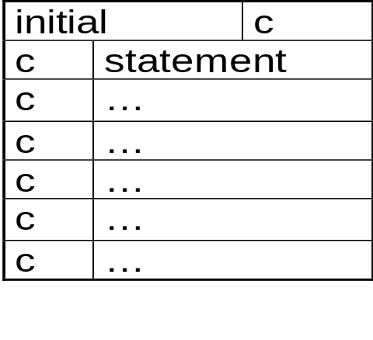
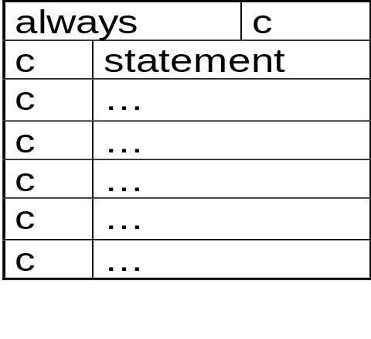
Procedural blocks have the following components
  procedural assignment statements
  timing controls
  high-level programming language constructs

Slide 23
RTL Statements
  Procedural and RTL assignments
    reg & integer
    out = a + b ;
  begin . . . end block statements
    group statements
  if. . . else statements
  case statements
  for loops
  while loops
  forever loops
  disable statements
    disable a named block

Slide 24
Combinational Always Blocks
A complete sensitivity list (inputs)
  always @(a or b or c)
    f = a&~c | b&c ;
Parentheses
  always @(a or b or c or d)
    z = a + b + c + d ; // z = (a+b) + (c+d) ;

Slide 25
Combinational Circuit Design
Outputs are functions of inputs
Examples
  MUX
  decoder
  priority encoder
  adder
inputs
comb.
circuits
Outputs

Slide 26
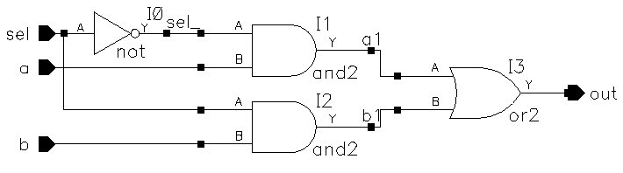
Multiplexor
Net-list (gate-level)
  module mux2_1 (out,a,b,sel) ;
    output out ;
    input a,b,sel ;
    not (sel_, sel) ;
    and (a1, a, sel_) ;
    and (b1, b, sel) ;
    or (out, a1, b1) ;
  endmodule

Slide 27
Multiplexor
Continuous assignment
  module mux2_1 (out,a,b,sel) ;
    output out ;
    input a,b,sel ;
    assign out = (a&~sel)|(b&sel) ;
  endmodule
RTL modeling
    always @(a or b or sel)
    if(sel)
      out = b;
    else
      out = a;

Slide 28
Verilog Simulation
A simple example
    module mux2_1 (out,a,b,sel) ;
    // Port declarations
    output out ;
    input a, b, sel ;
    // The netlist
    not (sel_, sel) ;
    and (a1, a, sel_) ;
    and (b1, b, sel) ;
    or (out, a1, b1) ;
    endmodule

Slide 29
A test fixture
  module test_mux ;
  reg a, b, sel ;
  //MUX instance
  mux2_1 mux (out, a, b, sel) ;
  //Stimulus
  initial
  begin
  a=0 ; b=1 ; sel=0 ;
  #5 b=0 ;
  #5 b=1 ; sel=1 ;
  #5 a=1 ;
  #5 b=0 ;
  end

Slide 30
  //Display results
  initial
  begin
  $display(" time out a b sel");
  $monitor($time, " %b %b %b %b", out,a,b,sel) ;
  end
  initial
  begin
  $dumpfile("mux_t.vcd");
  $dumpvars;
  end
  endmodule

Slide 31
Conclusions
Verilog modeling
  structured modeling
  continuous assignment
  RTL modeling

